Slide 1

“Space Data Processing: Making Sense of Experimental Data”
Laboratory work 1
Relationship between solar radio flux F10.7 and sunspot number
Tatiana Podladchikova Rupert Gerzer
Term 4, March 28 – May 27, 2016
t.podladchikova@skoltech.ru

Slide 2
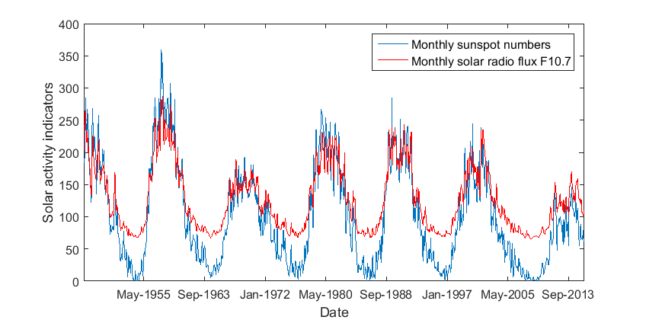



Main indicator of solar activity
Sunspot number
Solar radio Flux at 10.7 cm
$$R=k(n+10g)$$
$n$– number of observed sunspots
A measurement of radio emission at a wavelength of 10.7 cm (2800 MHz) from all sources present on the solar disk
$g$– number of observed sunspot groups
$k$– coefficient of a telescope

Slide 3
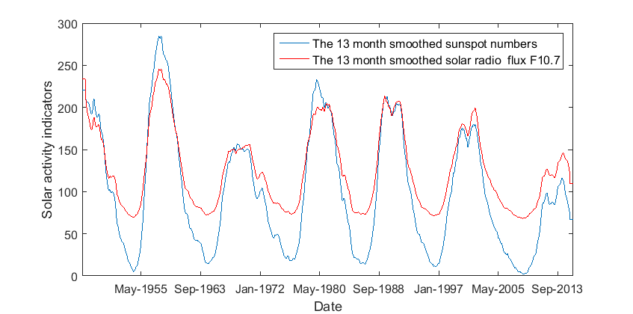
Smoothing: 13-month running mean

Slide 4
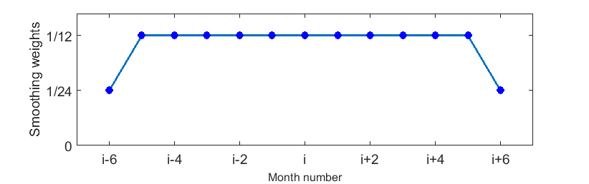













13-month sequent monthly mean sunspot numbers
$i$-6
$i$-5
$i$-4
$i$-3
$i$-2
$i$-1
$$i$$
$i$+1
$i$+2
$i$+3
$i$+4
$i$+5
$i$+6
13-month running mean $\overline{R}$
$$\frac{1}{24}R_{i−6}+\frac{1}{12}{(R}_{i−5}+R_{i−4}+…+R_{i−1}+R_{i}+R_{i+1}+…+R_{i+5})+\frac{1}{24}R_{i+6}$$

Slide 5
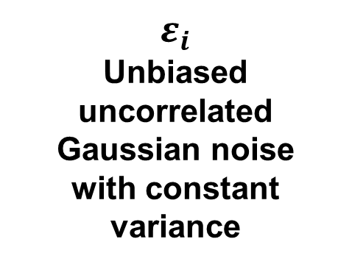
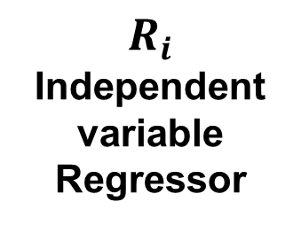

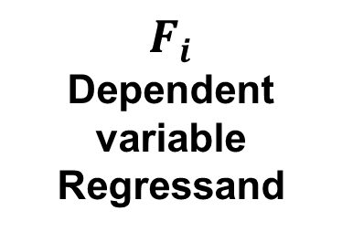



Multi-dimensional linear regression
$$F_{i}=β_{0}+β_{1}R_{i}+β_{2}R_{i}^{2}+β_{3}R_{i}^{3}{+ε}_{i}$$
$$i=1,….N$$
$F_{i}$
Dependent
variable
Regressand
$R_{i}$
Independent variable
Regressor
$ε_{i}$
Unbiased
uncorrelated
Gaussian noise
with constant variance
$β_{j}$
Coefficients of regression
Coefficients $β_{j}$ are determined by LSM
$$\sum_{i=1}^{N}{ε_{i}^{2}} →min$$

Slide 6
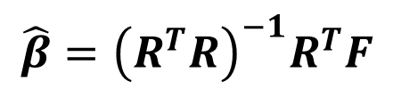





Multi-dimensional linear regression
$$F=\left|\begin{aligned}\begin{matrix}f_{1} \\ f_{2} \\ …\end{matrix} \\ f_{N}\end{aligned}\right|$$
$$β=\left|\begin{aligned}\begin{matrix}β_{0} \\ β_{1} \\ β_{2}\end{matrix} \\ β_{3}\end{aligned}\right|$$
Vector of dependent
variables
Vector of coefficients
$$R=\left|\begin{matrix}1 & r_{1} & r_{1^{2}} & r_{1}^{3} \\ 1 & r_{2} & r_{2}^{2} & r_{3}^{3} \\ … & … & … & … \\ 1 & r_{N} & r_{N}^{2} & r_{N}^{3}\end{matrix}\right|$$
Matrix of independent
variables
$$ε=\left|\begin{aligned}\begin{matrix}ε_{1} \\ ε_{2} \\ …\end{matrix} \\ ε_{N}\end{aligned}\right|$$
Vector of random errors
Linear regression in matrix form
$$F=R⋅β+ε$$
$$\hat{β}={\left(R^{T}R\right)}^{−1}R^{T}F$$
Linear Regression Analysis, G.A.F. Seber and J. Lee, Wiley, N.Y., 2003

Slide 7
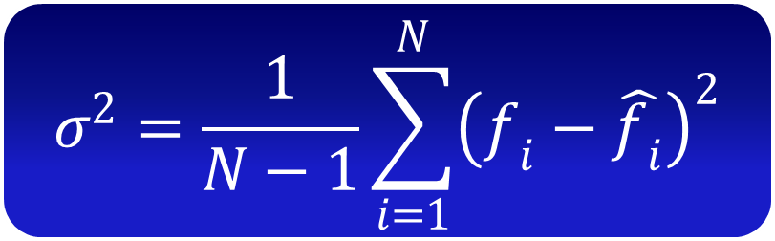
Estimation error of solar radio flux F10.7
$$σ^{2}=\frac{1}{N−1}\sum_{i=1}^{N}{{\left(f_{i}−\hat{f_{i}}\right)}^{2}}$$
Covariance matrix of estimation error

